Slide 1



Dobby
Your AI Virtual Assistant. Scheduling and Calendar Management
Let Dobby free up your time to focus on what matters most.
Robin WARROT, Olivia DE LA CHAPELLE, Killian LE METAYER,
Juntao LIANG, Poongkundran THAMARAISELVAN
21/06/2024

Slide 2
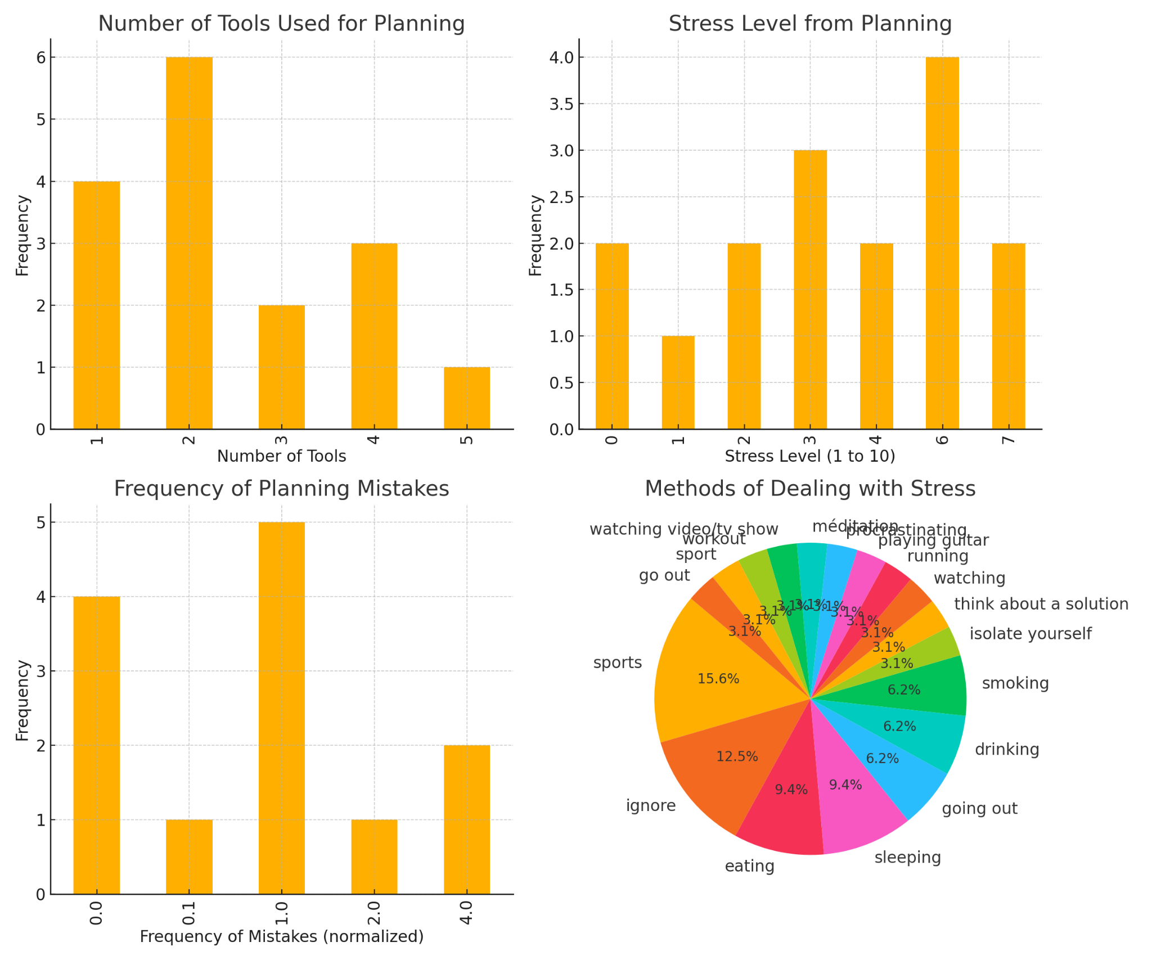
Apparently, we are all concerned by this topic …
There is no perfect centralized tool for scheduling that answers our needs
2. We all experience some type of stress linked to planning
3. We tend to rely on no so recommendable activities to cope with stress
Using Virtual Assistants is use to release stress 34% of the time, increases by 137% productivity and will reduce significantly the number of mistakes made.
Notes:
We ran a small survey on student on the class: here is what we have learnt:
no perfect centralized platform that answers our needs (as some of us need to write, others to speak, some on paper, others online)
all experience some type of stress linked to planning (keep in mind that we still have student schedules, how it is going to be when working ?)
Worst? How do we deal with stress ?
And this is visible in general surveys in companies.

Slide 3

Two main problems to address
1
Time loss
Manually updating calendars, managing invites, and rearranging schedules is a repetitive, time-consuming chore.
2
High mental load
Keeping track of multiple calendars (personal and professional), priorities, and deadlines can lead to stress and burnout.
Notes:
What are the two main problems with scheduling:
Time consumption and high mental load

Slide 4
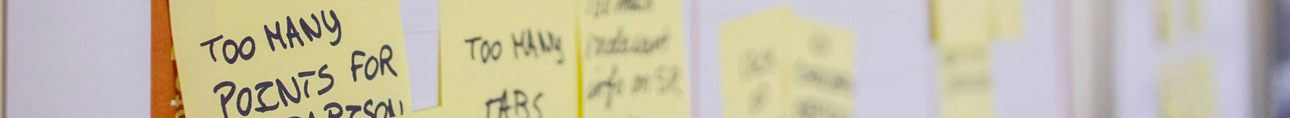
Solution.
An automated, Intelligent Calendar Coordination
Live vocal or written conversation with your assistant
AI-powered optimization algorithm
Automated scheduler
An efficient way to communicate changes in agendas is through vocal notes and written discussions to your assistant, instead of doing it manually.
The AI assistant will be able to save all given changes, send you notifications and reminders and be in charge of updates.
The AI assistant will seamlessly optimize and rearranges schedules based on your preferences and availability.
Notes:
productivity etc (Impact)

Slide 5

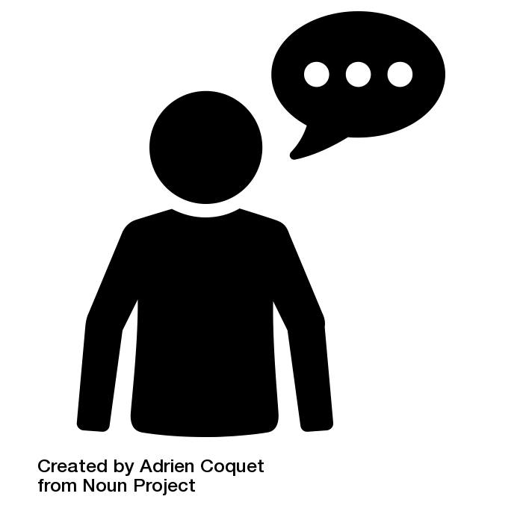
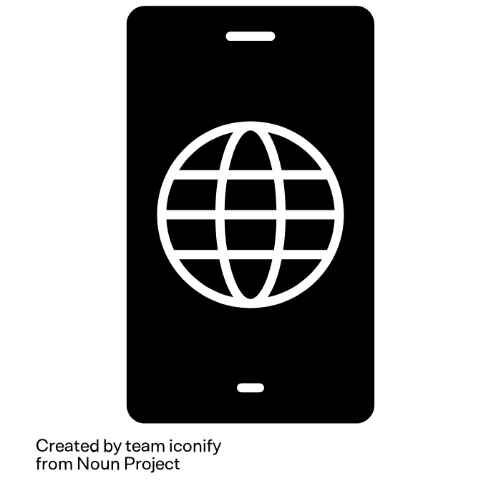
The Customer Journey
Iterate
Provide additional information
Initialization
Send a text or vocal message to the app to ask to add a calendar event
Asks additional information if not exhaustive
Nb hours
Priority / Due date
Number of timeslots to allocate
(if we have time to implement: retrieve the next week and decide when is the best time)
Adds the event to the Google calendar (including a reminder at the right time)
Download app
Connect to any calendar
App Preferences (google form)
“Account initialized”
“Hey Assistant, I need to do a Homework about GenAI.
I think it should take around 6 hours to do.
Please book time slots in my agenda to dedicate to this”
‘When is it due?”
“Event added to your agenda.
Reminder added 1 hours before.”
“In 1 month”

Slide 6
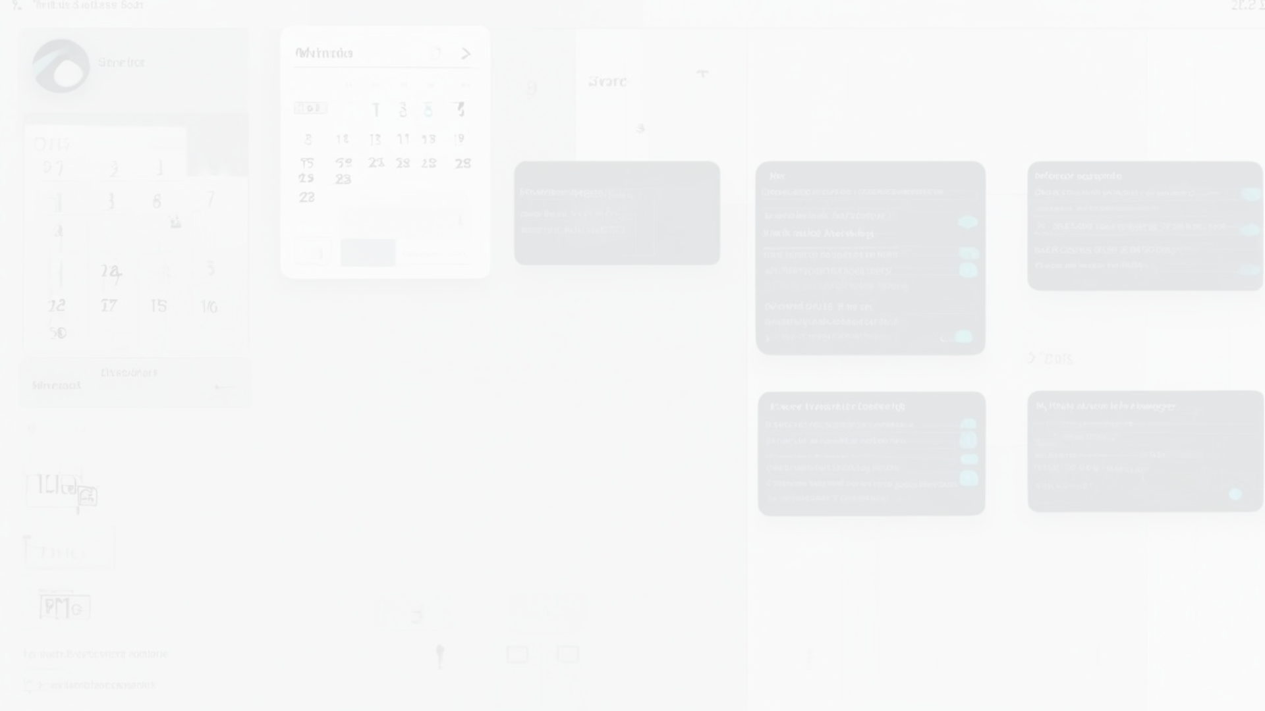

Proof of Concept (POC)
DEMO

Slide 7

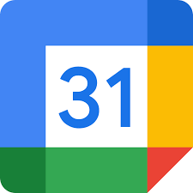

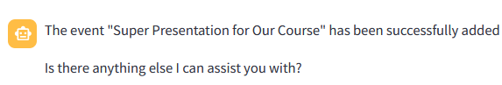

What Dobby is actually doing in the background
3
Server
1
Ask chatgpt the question, telling that it can use tools if needed
Executes Python functions asked by chatGPT
Google Calendar
Asks to call a tool with specific parameters
Get_events()
2
4
Add_event()
API requests
Receives the answer
6
5
Modify_event()
7
If doesn’t need to call tools anymore
Delete_event()

Slide 8
Market validation & size
AI Market Projection
2024: $184.00 billion
2030: $826.70 billion
CAGR: 28.46%
Productivity Software Market
2024: $79.07billion
2030: $88.05 billion
CAGR: 2.73%
Market Analysis of AI Virtual Assistants
Intelligent Virtual Assistant Market Growth
2024: $14.77 billion
2029: $60.83 billion
CAGR: 32.72%
Total Available Market
Google Calendar: 500M users
Microsoft Teams: 300M users

Slide 9
Business Model
Subscription Model
800 Million
8M
$0,99/Month
$95M
Total Available Market
(number of virtual calendar users worldwide)
Share of Market
1% of Available Market
Monthly Subscription
Estimated Yearly Revenue
Additional Revenues Streams
Advertising: Ad placements within the app partnering with productivity tool companies.
Data Analytics: Selling anonymized usage data adhering to privacy laws.
Potential Exit Strategy: Acquisition by a tech giant (e.g., Google, Microsoft, Apple) or a productivity tool company.

Slide 10



Competitors Analysis
Competitors | Strengths | Weaknesses
Microsoft Cortana | Deep integration with Microsoft Office Suite and Windows OS Strong capabilities in task scheduling and reminders | Limited proactive assistance Less focus on personalized scheduling.
Google Assistant | Excellent integration with Google services Available on a wide range of devices | Responding to commands rather than anticipating needs Privacy concerns with data collection
Apple Siri | Seamless integration with the Apple ecosystem Strong voice recognition and natural language processing | Limited learning capabilities for personalized scheduling Restricted to Apple devices
Unique Selling Proposition of Our Product
Dobby | Cross-Platform Integration: Seamlessly works with all calendar providers, across various devices and operating systems. Personalization: Highly personalized and proactive assistance (including voice recognition) Advanced AI Capabilities: Leverages cutting-edge AI for better scheduling and task management (including finer optimization with weather and maps information to calculate travel time to meetings)

Slide 11



Next Steps
Beta Testing
Product Launch
Ongoing Development
Conduct a limited-release beta test for free to gather user feedback and refine the product.
Officially launch the AI virtual assistant, with comprehensive marketing and onboarding support.
Continuously enhance the solution by incorporating user insights and evolving AI capabilities.

Slide 12
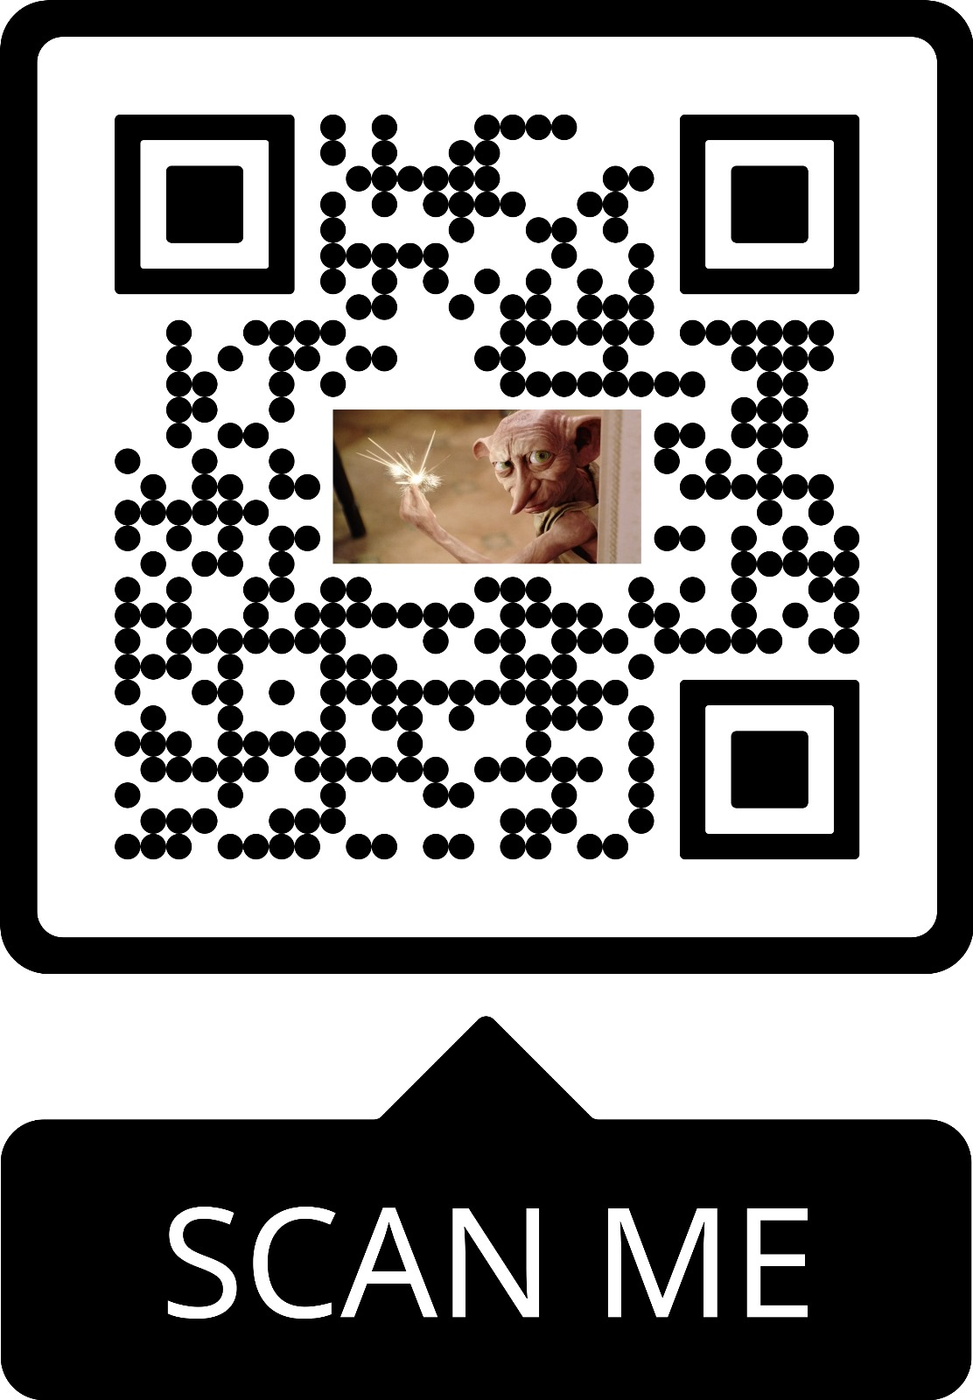
We listen to your questions while you can use the app!
Go as quickly as you can!
Add new events
Move or modify events
Delete events
Ask information

